Slide 1
Sorting algorithm
In computer science, a sorting algorithm is an algorithm that puts elements of a list in a certain order.

Slide 2
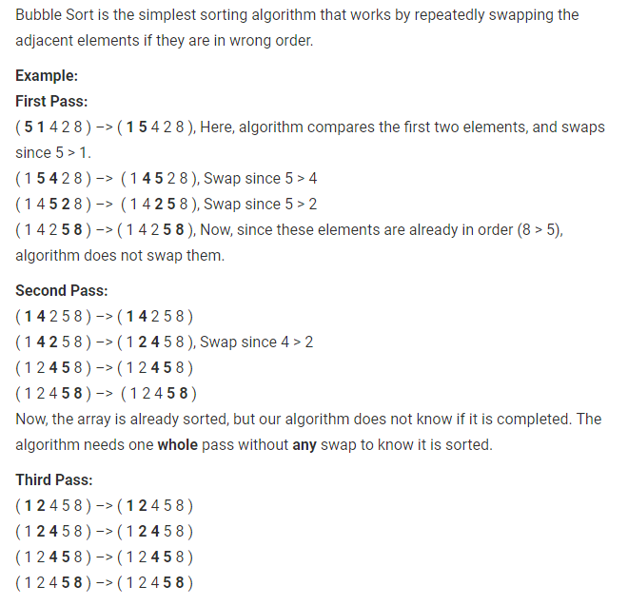
Bubble sort

Slide 3
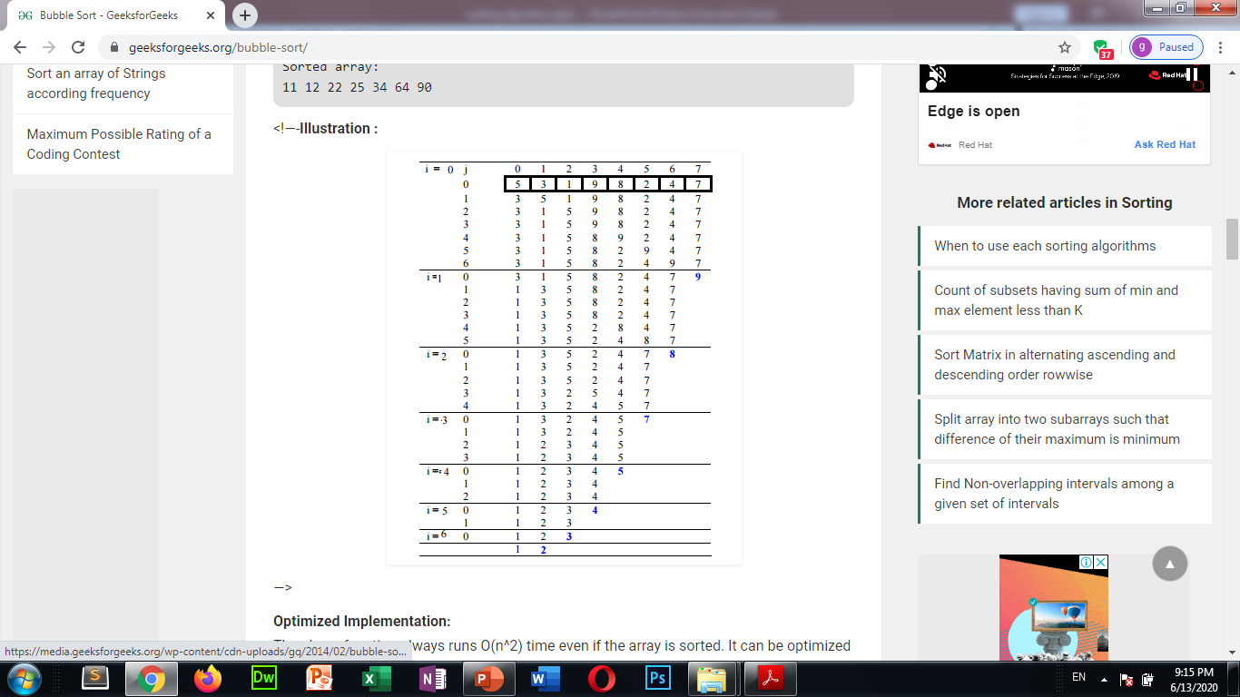

Slide 4
Insertion Sort Algorithm
Insertion sort is the sorting mechanism where the sorted array is built having one item at a time. The array elements are compared with each other sequentially and then arranged simultaneously in some particular order.

Slide 5
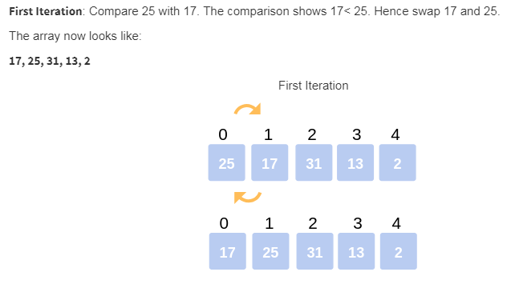

Slide 6
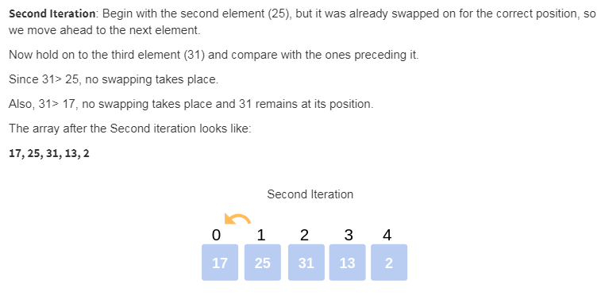

Slide 7
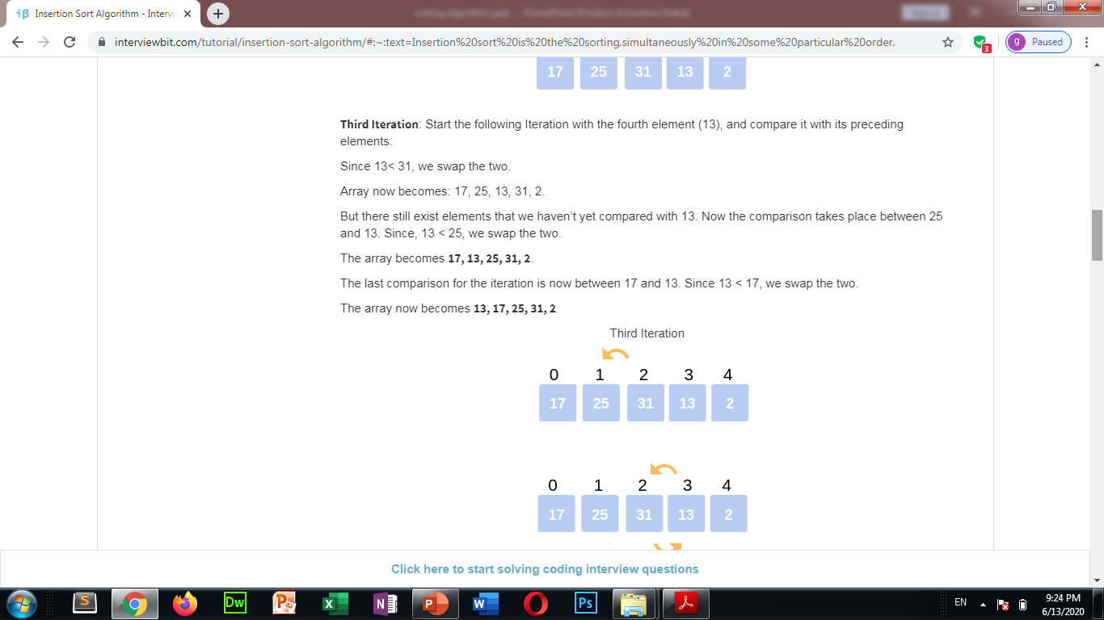

Slide 8
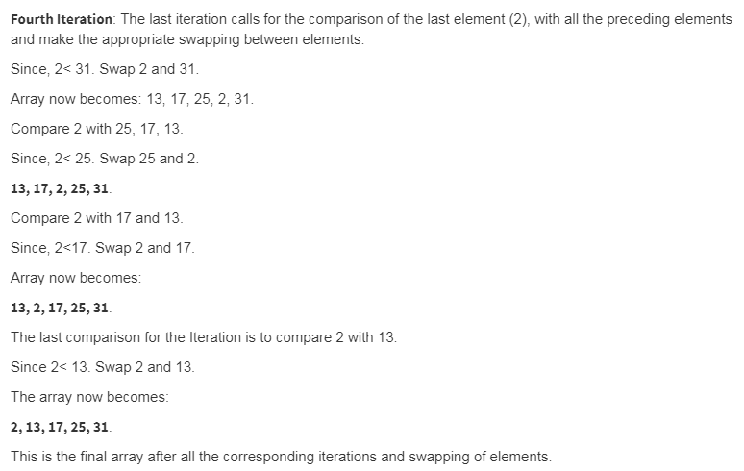

Slide 9
thanks

